Slide 1
Single Cell Sequencing

Slide 2
Single cell sequencing
First publication by Tang et al 2009, gained popularity after 2014
Measures the expression levels of genes across a population of individual cells
Data size from 10²-10⁵
Allows study of cell-specific changes

Slide 3
Single cell sequencing
Some applications:
Cell type identification
Study heterogeneity of cell responses
Gene regulatory networks across cells
Gene expression stochasticity

Slide 4
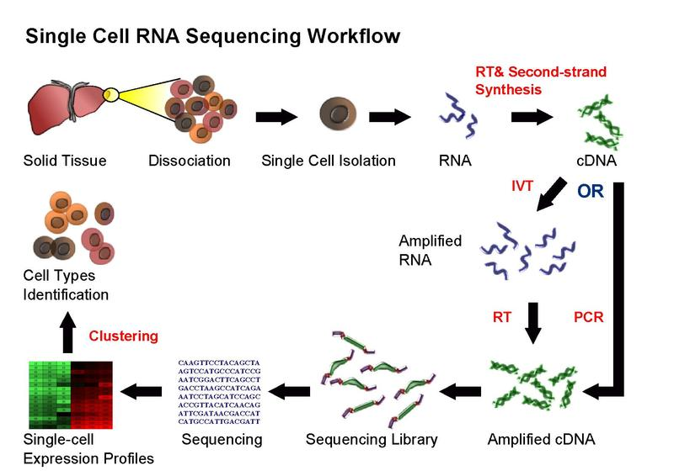
Typical workflow

Slide 5
Experimental methods
Different protocols for isolation and preparation of single cells available
CEL-seq, CEL-seq2, Drop-seq, InDrop-seq, MARS-seq, Seq-well, Smart-seq, smart-seq2, SMARTer

Slide 6
Methods
Capture
Quantification

Slide 7
Quantification
Full-length
Tag-based

Slide 8
Quantification
Full length covers uniform read coverage of each transcript
Tag-based captured either 3’ or 5’ –end of RNA
Tag-based are more commonly used and can be combined with Unique Molecular Identifiers (UMI)

Slide 9
Capture
The capture strategy determines the throughput, and how cell can be selected
Capture
Microwell
microfluidic
droplet

Slide 10
Microwell-based
Cells are isolated using pipette or laser capture and placed in microfluidic wells.
Can be combined with fluorescent activated cell sorting (FACS), making it possible to select cells based on surface markers.
Another advantage is that one can take pictures of the cells. The image provides an additional modality and a particularly useful application is to identify wells containing damaged cells or doublets.
Are often low-throughput and the amount of work required per cell may be considerable.

Slide 11
Microfluidic-based
An integrated system for capturing cells and for carrying out the reactions necessary for the library preparations
High throughput compared to microwells
Expensive
Fluidigm C1

Slide 12
Droplet-based
Each individual cell is encapsulated inside a nanoliter droplet together with a bead.
The bead is loaded with the enzymes required to construct the library.
Each bead contains a unique barcode which is attached to all of the reads originating from that cell. Thus, all of the droplets can be pooled, sequenced together and the reads can subsequently be assigned to the cell of origin based on the barcodes.

Slide 13

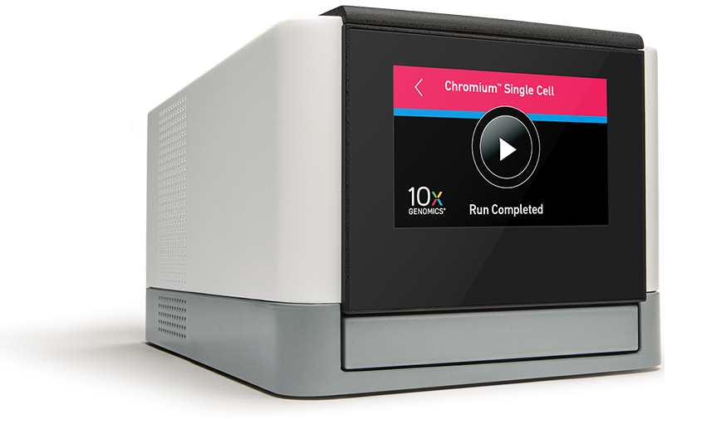
Commercial platforms
Fluidigm C1
10x Genomics Chromium
Notes:
Source: https://www.10xgenomics.com/single-cell/
https://www.fluidigm.com/products/c1-system

Slide 14
The Fluidigm C1
The C1 system provides a simple plug-and-play workflow to reproducibly prepare 96 individual cells in about one hour of hands-on time
PRIME
CAPTURE
STAIN
LYSE
AMPLIFY
HARVEST

Slide 15
Workflow
The innovative C1 system carefully isolates single cells into individual reaction chambers in the exclusive Fluidigm integrated fluidic circuit (IFC). The optically clear IFC lets you automatically stain captured cells and examine them by microscopy for viability, surface markers or reporter genes. After staining, cells are automatically lysed and template is quickly prepared for qPCR or sequencing analysis—all in as little as four hours.

Slide 16
TYPES OF IFC
C1 mRNA SEQ HT IFC
Five C1 Single-Cell mRNA Seq HT IFC for capture, lysis, reverse transcription and cell multiplexing of 800 individual medium cells (10–17 µm).

Slide 17
TYPES OF IFC
C1 DNA SEQ IFC
One workflow allows to isolate and process 96 cells to explore cell lineage at Whole genome, exome or targeted loci. Designed to capture 5-25 µm

Slide 18
TYPES OF IFC
C1 Preamp IFC
Enables targeted gene expression to verify gene signatures or study miRNA gene expression.
Designed to capture 5-25 µm

Slide 19
TYPES OF IFC
C1 mRNA SEQ IFC
Designed for absolute quantification or full transcript sequencing
96 cells at a time
Designed to capture 5-25 µm

Slide 20
TYPES OF IFC
C1 Open App IFC
96 cells
Designed to capture 5-25 µm
Can be used for Metagenomics

Slide 21
TYPES OF IFC
C1 Open App IFC
96 cells
Designed to capture 5-25 µm
Can be used for Metagenomics

Slide 22
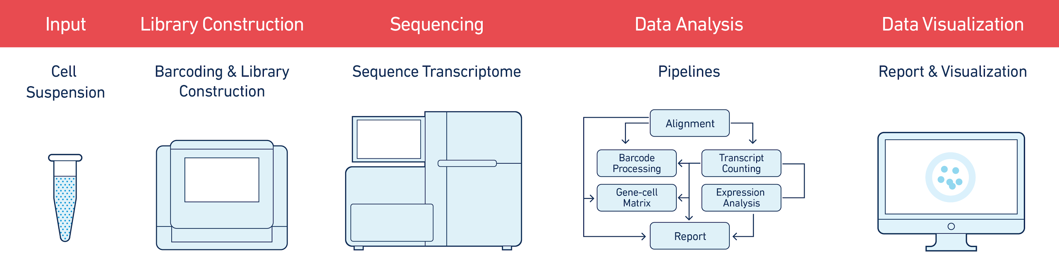
Chromium Single Cell 3’
GEM is a gel bead in emulsion droplet that encapsulated each micro-reaction within Chromium system

Slide 23
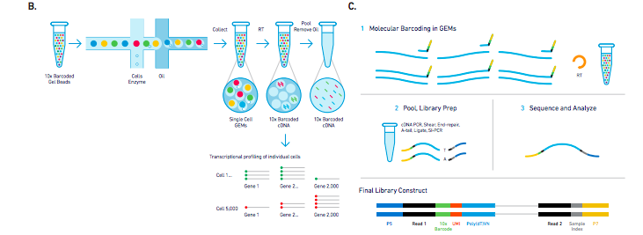
Chromium Single Cell 3’
(b) Formation of GEMs, RT takes place inside each GEM, which is then pooled for cDNA amplification and library construction in bulk. (c) v2 Single Cell Assay schematic overview.

Slide 24
Workflow for Single-cell analysis
Read QC
Alignment
Mapping QC
Cell QC
Normalization
Confounders
Confounders
Differential expression
Clustering
Network

Slide 25
Other droplet-based platforms
Chromium from 10x Genomics
ddSEQ from Bio-Rad Laboratories
InDrop from 1CellBio
μEncapsulator from Dolomite Bio/Blacktrace Holdings

Slide 26
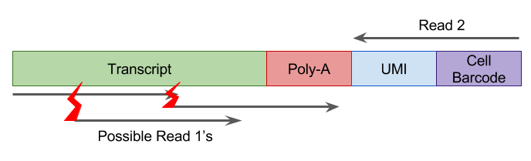
Unique Molecular Identifiers (UMI)
Short 4-10 bp random barcodes added to transcripts during library prep
Enables sequencing reads to be assigned to transcripts
Reduces Noise and biases in scRNAseq

Slide 27
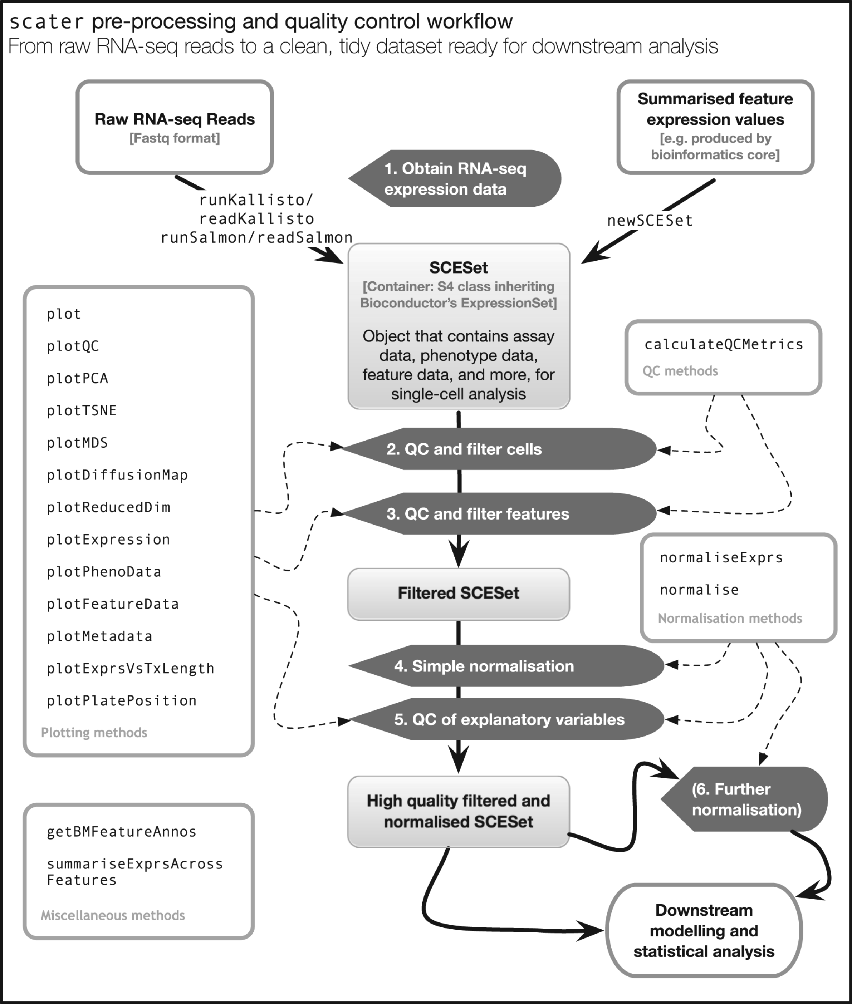
Scater package for QC and analysis of scRNAseq
Notes:
Fig. 1. An overview of the scater workflow, from raw sequenced reads to a high quality dataset ready for higher-level downstream analysis. For step 5, explanatory variables include experimental covariates like batch, cell source and other recorded information, as well as QC metrics computed from the data. Step 6 describes an optional round of normalization to remove effects of particular explanatory variables from the data. Automated computation of QC metrics and extensive plotting functionality support the workflow
27

Slide 28
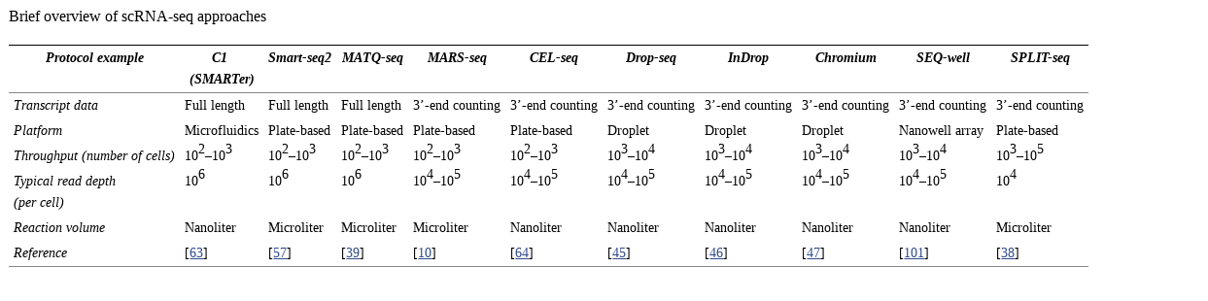

Slide 29
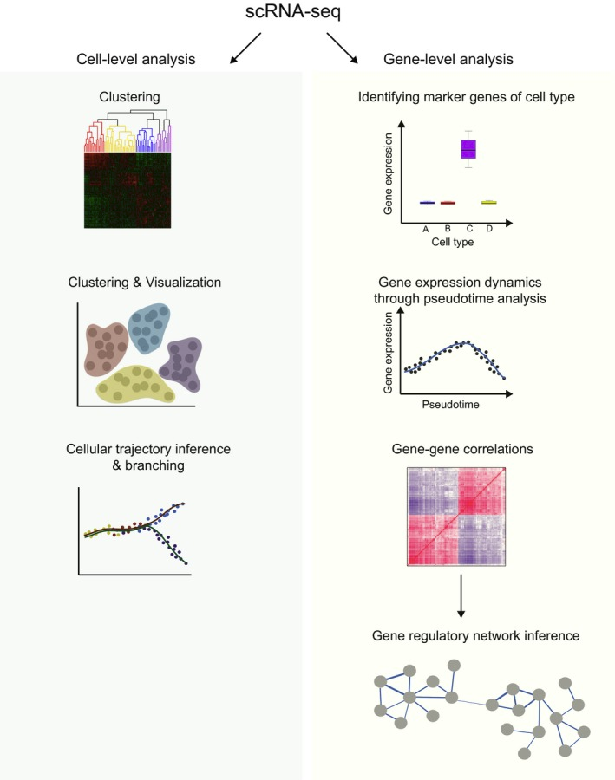
FEBS Lett. 2017 Aug; 591(15): 2213–2225.

Slide 30
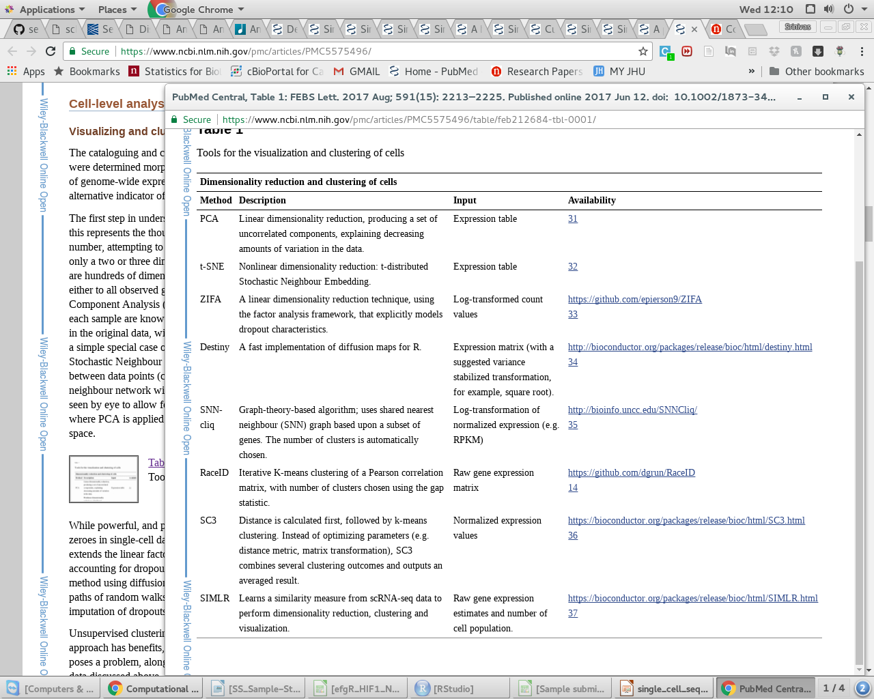
FEBS Lett. 2017 Aug; 591(15): 2213–2225.

Slide 31
Representative papers

Slide 32
Single-cell RNA-seq reveals new types of human blood dendritic cells, monocytes, and progenitors.
Dendritic cells (DCs) and monocytes consist of multiple specialized subtypes that play a central role in pathogen sensing, phagocytosis, and antigen presentation
Their identities and interrelationships are not fully understood
Cell populations have historically been defined by a combination of morphology, physical properties, localization, functions, developmental origins, and expression of a restricted set of surface markers

Slide 33
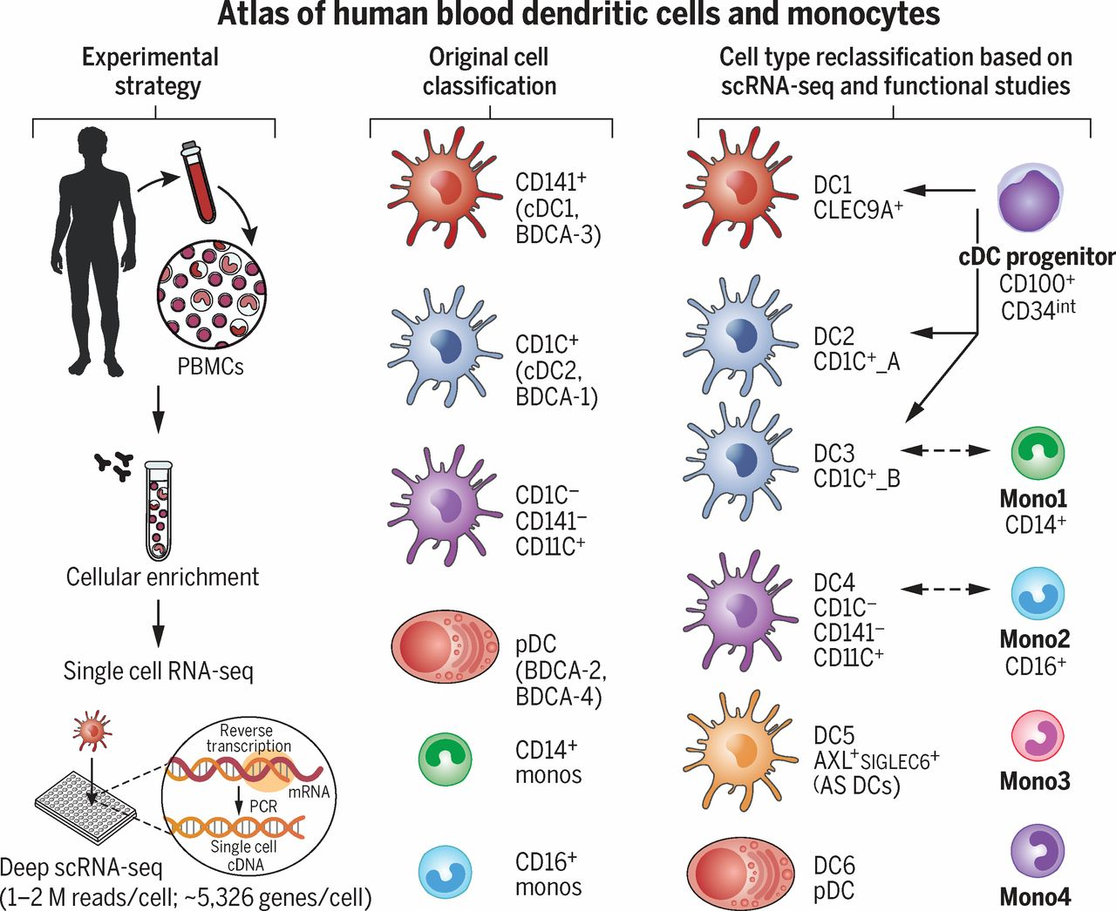
Single-cell RNA-seq reveals new types of human blood dendritic cells, monocytes, and progenitors.
Performed single cell RNA-Seq of ~2400 cells
Identified and validated 6 DC subtypes and 4 monocyte subtypes

Slide 34
Experimental and computational strategy
Perform single-cell RNA sequencing on DCs and monocytes derived from a single healthy individual
Identify clusters of cells that are similar to each other
Find discriminative markers per cluster
Prospectively isolate cells corresponding to key clusters using newly identified surface markers
Validate the identity of the sorted cells using scRNA-seq
Confirm the existence of these cell types in up to 10 independent healthy individuals
Perform functional analyses for selected cell types

Slide 35
Experimental and computational strategy
SmartSeq2 protocol was used on single FACS sorted cells
For DCs, a total of 8 x 96-well plates (768 single DCs) were initially profiled
For monocytes, a total of four 96-well plates were profiled (372 single monocytes and 12 population samples)
Additional, 1244 cell were profiled to characterize various other DC subsets
After library prep, 384-pooled cells were sequenced as paired-end 25 base pair reads on a HiSeq 2500

Slide 36
Experimental and computational strategy
Reads aligned to hg19 transcriptome
RSEM was used to quantify the gene expression at TPM levels
Filtered low quality cells based on number of genes expressed
Minimum of 3000 unique genes/cell for cells sequenced at HiSeq 2500 depth, and 2000 unique genes/cell for cells sequenced at MiSeq depth
Genes not detected in atleast 0.5 % of cells discarded
Total of 21,581 genes analysis ready
Data log transformed ->log(TPM+1)
Any Batch effects were removed using “latent variable approach”
Notes:
Briefly, we fit a linear model to predict the expression value of each gene based on a batch indicator variable, as well as the total number of unique genes detected in that cell. We considered the residual expression from this model as a ‘corrected’ gene expression value, and used these values as input to the downstream clustering analyses.

Slide 37
Experimental and computational strategy
Removed any contaminating cells using PCA analysis (basophils)
Remaining cells were clustering using a graph-based approach
Excluding all genes that were very lowly expressed on average, (log(TPM+1)<1) and used a z-score cutoff of 1 to select variable genes, resulting in the selection of 595 variable genes across the 742 Dcs
Reduced the dimensionality of data using statistically significant PCA components
Identified a total of 5 PCs
Applied tSNE to the PCA loadings to visualize the data

Slide 38
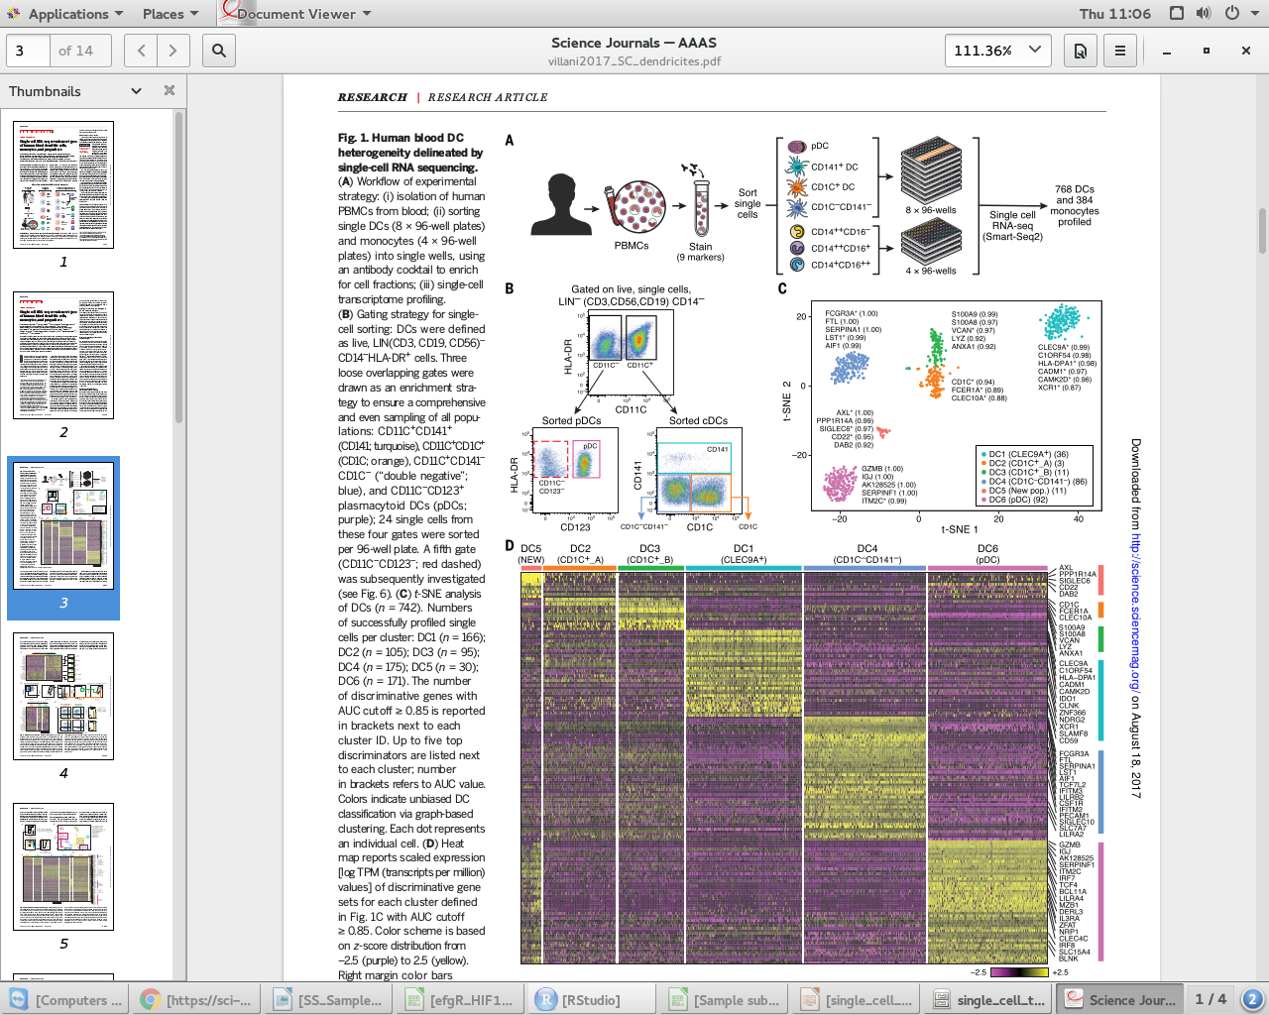

Slide 39
Experimental and computational strategy
Identification of markers for each cluster was performed further
Aim was to identify genes whose expression values could individually serve as a binary classifier for cell identity
For each gene, the reported AUC value corresponds to the area under the receiver-operating curve
Trajectory analysis performed using monocle

Slide 40
Deep sequencing reveals cell-type-specific patterns of single-cell transcriptome variation
High quality deep read-depth single-cell RNA sequencing for 91 cells from five mouse tissues and 18 cells from two rat tissues, along with 30 control samples of bulk RNA diluted to single-cell levels
Cells sorted using FACS
Library prep using manufacturer protocol
Samples were sequenced on HiSeq instruments to produce 100-base paired-end reads

Slide 41
Alignment, quantification and sample selection
Reads trimmed for adapter and poly(A) contamination
Aligned to mouse genome and transcriptome using RNA-Seq unified mapper
Read counts using HTSeq against RefSeq mouse transcripts
Rat samples aligned using STAR
Samples with high geneic read coverage (>5 million uniquely mapping)
Atleast 50 % uniquely mapping reads, and at least 1500 genes covered at reasonable depth (greater than ten reads), and less than 80 % short fragments

Slide 42
Alignment, quantification and sample selection
To mitigate differences in read counts due to variable sequencing depth, psuedoreference based normalization carried out
Principle component analysis of gene expression data was performed after variance stabilizing relative frequencies by arcsine transform
Genes with zero read count discarded
Genes with atleast one uniquely aligned read deemed expressed
Consistent genes -single read in all samples
Gene expression variability was measured using various statistics

Slide 43
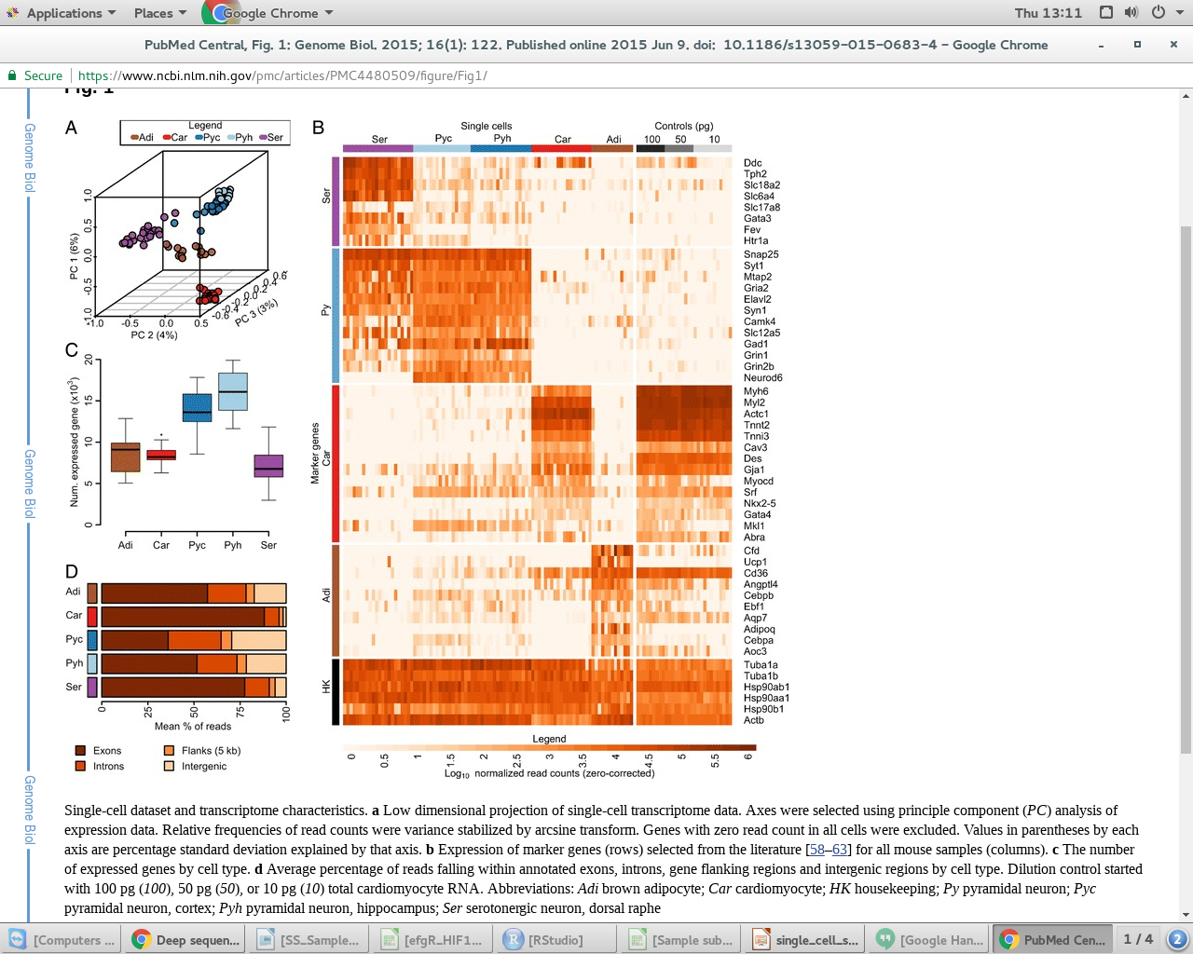

Slide 44
Topics studied in the paper
Complexity in the single cell
Consistent gene expression across various cells
Variation in expression pattern across cells
Any Variability with the cell types
Association of variability with RNA high life
Sequence variation at the 3' level if any

Slide 45
Single-cell gene expression analysis reveals regulators of distinct cell subpopulations among developing human neurons
Single cell RNA-Seq of developing neurons to dissect Neuronal precursor cells (NPC) subtypes
And to study NPC to neuron transitions
GOALS
(1) Seperating the different cell subtypes and cell states of a given mixed population;
(2) defining what is the mechanism underlying the specification of different cell subtypes and different cell states
(3) understanding what are the dynamic differences between distinct subpopualitons that arise during development

Slide 46
Experimental method and analysis
88-96 cells for each time point (days 0, 1, 5, 7, 10 and 30)
using C1 single cell system
After QC, 8957 genes from 483 cells produced high-quality expression data by scRNAseq
Raw data were processed and mapped to hg19 using TopHat and quantified using HTSeq against GENCODE
CELL QC -total mapped reads in each cell >1 million
Number of genes detected
8957 expressed genes and 483 cells for downstream analysis. The gene expression levels were normalized using DEseq2

Slide 47
Differential expression analysis
Differential expression analysis using single-cell differential expression (SCDE), a bayesian approach accounting for frequent dropout events and Biological variability
A total of 528 DEG with fold change >1.5 and p-value <1e7
Cell sub population analysis
Hierarchical clustering was used to cluster subpopulations of the cells in each time point. Two clusters from each time point except day 1 and 5
Next, the differential expression analysis between pairs of cell subpopulations in each time poin was performed
The Pearson correlation coefficients were calculated between the cell subpopulation in the earlier time point to the cell subpopulation in neighboring time points

Slide 48
